Slide 1
Syrian Arab Republic
Syrian Virtual University
ITI-310
Windows Server 2008
Introduction To Active Directory
By: eng. Atef Al-Abdullah
Spring 2007

Slide 2
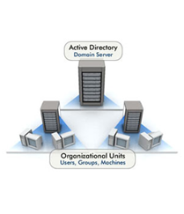
Directory Service - Definition
Computerized directory service definition
  Novell Directory Services (NDS)/ eDirectory in Netware 6.
  In windows 2000.
Computerized directory service requirements
  structure to organize and store directory data.
  means to query and manage directory data.
  method to locate directory data
Eng. Atef Al-Abdullah
١٤٤٨/٠٥/٢٨ 16:11

Slide 3
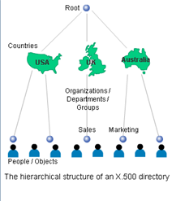
Active Directory – Organizing and Storing Data
Structure
  ISO X.500
Managing Data
  Lightweight Directory Access Protocol (LDAP) .
  TCP port 389.
Locating Data and Resources
  Domain Name Service (DNS).
Eng. Atef Al-Abdullah
١٤٤٨/٠٥/٢٨ 16:11

Slide 4
Active Directory Structure
Logical Structure:
  Organizational Unit (OU).
  Domain.
  Tree.
  Forest.
Eng. Atef Al-Abdullah
١٤٤٨/٠٥/٢٨ 16:11

Slide 5
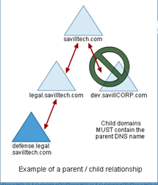
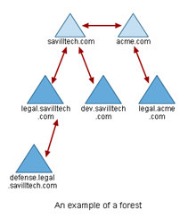
Trees and Forests in Domains
Eng. Atef Al-Abdullah
١٤٤٨/٠٥/٢٨ 16:11

Slide 6
Active Directory Structure
Physical Structure:
  Sites.
  Subnets.
  Links.
Eng. Atef Al-Abdullah
١٤٤٨/٠٥/٢٨ 16:11

Slide 7
Active Directory
Name Space.
Global Catalogue.
AD and DNS Integration.
Global Unique Identifier.
Eng. Atef Al-Abdullah
١٤٤٨/٠٥/٢٨ 16:11

Slide 8
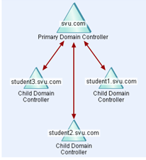
Multi-master Replication
    Domain Controllers are equals.
    Update Sequence Number (USN).
    Replication Cycle.
    Up-To-Date Vectors.
      Globally Unique Identifier (GUID).
      Up-to-Date Vector .
      High-Watermark Vector .
 | Current USN | New USN | Needed Updates
DC B | 54 | 58 | 55-58
DC C | 23 | 23 | Up to date
DC D | 53 | 64 | 54-64
Eng. Atef Al-Abdullah
١٤٤٨/٠٥/٢٨ 16:11

Slide 9
Property Version Number PVN
    PVN
      Definition.
      Conflicts Resolving.
      Propagation dampening scheme.
Eng. Atef Al-Abdullah
١٤٤٨/٠٥/٢٨ 16:11

Slide 10
FSMO
  Flexible Single Master of Operation (FSMO) Roles:
    Forest Wide Roles
      Schema master.
      Domain naming master.
    Domain Wide Roles
      Relative ID (RID) master.
      PDC emulator.
      Infrastructure master.
Eng. Atef Al-Abdullah
١٤٤٨/٠٥/٢٨ 16:11

Slide 11
Domain VIA Workgroup
 | Workgroup | Domain
Users | Local Users only | Local and Central
Logon | Local
Shares | Separated in each machine
Access | All or local users only
Computers | Not found
Eng. Atef Al-Abdullah
١٤٤٨/٠٥/٢٨ 16:11

